Slide 1
NEO4J CYPHER TUTORIAL WITH PYTHON
Delete Nodes From Neo4j Graph By Reading Csv Input Using Cypher ,Apoc & Python
Tutorial 91

Slide 2
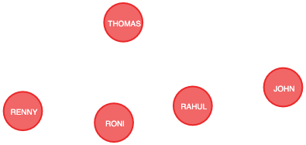
Present State

Slide 3
Sample csv
type,name
Student,RONI
Student,JOHN

Slide 4
Use case
Delete nodes from neo4j graph from csv input using cypher ,apoc & python

Slide 5
Pre-requisites
apoc.import.file.enabled=true
apoc.import.file.use_neo4j_config=false

Slide 6
Delete node from graph using csv input
call apoc.load.csv("file:///users/roni/Documents/GitHub/neo4j_python_use_cases/delete.csv")
yield map
with map
unwind map.type as type
unwind map.name as name
match (a{NAME:name})
unwind labels(a) as label
with a,type
where label=type
delete (a)
Code written in neo4j browser

Slide 7

output
From neo4j browser

Slide 8
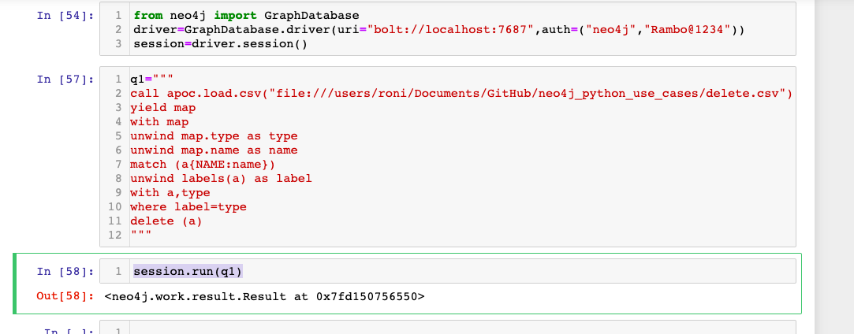
Delete node from graph using csv input
Code written in python ide

Slide 9
output
From python ide

